Slide 1
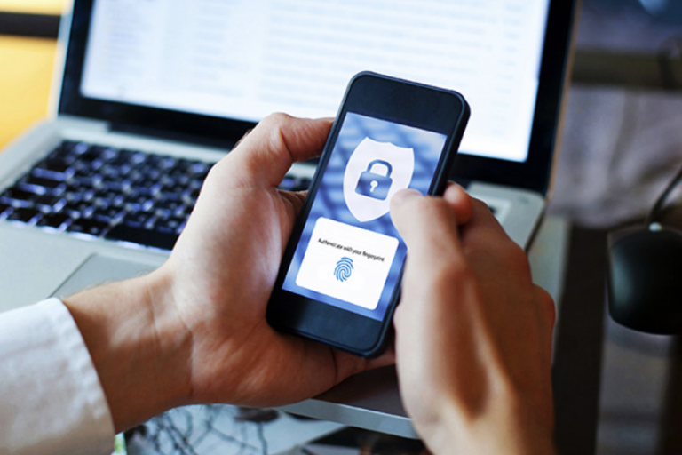

Biometrics in Security
By Lawrencia Agyemang

Slide 2

Biometrics
Security
Breaching of data
Hacking
Password

Slide 3
Biometrics
Biometric security refers to the application of technological software to recognize people automatically as supported by their biological and behavioral characteristics.
Users' body parts such as fingers, face, eyes, hands, voice, or heartbeats are used to identify the person before allowing access to devices such as cell phones and PC.

Slide 4
How it is used and what it is used for
It is a form of technology that allows devices to identify people based on information saved on the database.
Institutions have similarly embraced biometrics to grant or deny access to individuals based on who they are.
Therefore, the tensions based on the breaching of privacy of data have significantly reduced.
The system comes with convenience, where it saves time to identify.

Slide 5
where it can be used
Biometric security is used where maximum security is needed, especially when technological devices are used.
The law enforcers are also provided with biometrics which facilitates maintenance of security. For instance, the FBI agent has adapted the investigation of criminals through biometrics.

Slide 6
Conclusion
Biometrics security is part of the latest technology that is intended to provide safety. It has many advantages that exceed disadvantages, even if it is not perfect.
Many facilities such as banks, schools, homes, and personal gadgets are fixed with biometrics that enhances security.
Security issues are now improved especially with the introduction and use of biometrics.

