Slide 1
Digital forensic investigation
by:Dominique Taylor,Yonah Meconen, Kesha Williams, Jakari Devine, Kirby Feseha

Slide 2
Should A murder investigation be opened?
Yes it should! Crucial pieces of evidence will provide the reasonings behind this decision.
Visual Evidence
Explanations
Timelines

Slide 3
Suicide Note
To my loved ones,
I am so very sorry to be leaving you like this, but I am tired and must go. I made several bad business deals and have done but harm each and every one of you. I know it is selfish, but I must hurt you one last time and go.
All my love,
Yousef
According to the metadata, the author of this document wasn’t Yousef, it was Annie M. Groves
It was created 4/4/19
His death is assumed to be an overdose

Slide 4
Ketamine
There is evidence that the owner of this data was interested in studying Ketamine administration
This could possibly be what Yousef overdosed from

Slide 5
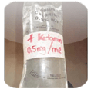
Ketamine cont.
This image of a ketamine infusion was found and was created 4/16/19
This could mean that the killer uses this as a means to kill other targets rather than just Yusef

Slide 6
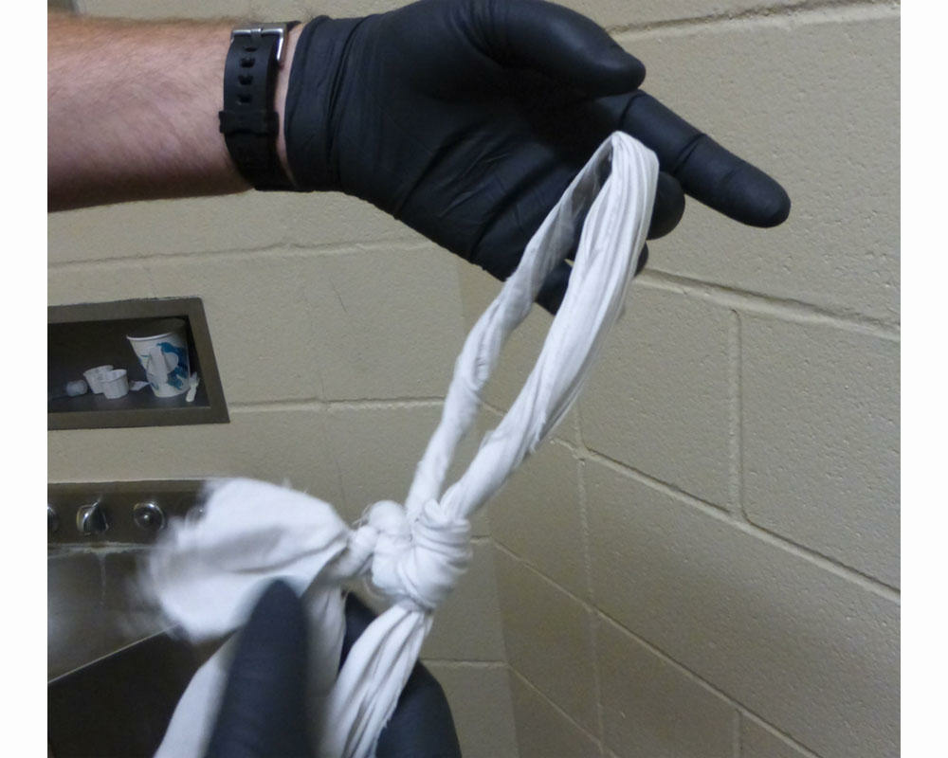
Bed sheet
This sheet was found at the
scene on 4/5/19 and could have
been used by the murderer while
the crime was being commited

Slide 7
Dark Mamba

Slide 8
Cryptography
There is a 4 page PGP Encrypted message
This can be an indication of communication with Dark Mamba
There is a deleted file “Cypher_wilderness.png” that could hold the key

Slide 9
Dark web
There was an article found detailing how a Virginia Beach stabbing related to a teen buying and selling drugs on the dark web taking high doses of Clonazonam.
The murderer could have accessed dark websites to purchase and use Kemtamine along with other drugs in high dosages to kill Yusef and other potential victims.

Slide 10
Evidence cont.
In different documents, single line messages have been placed in large paragraphs. These all involve Kasey Turnt, who an email was recently sent to.

Slide 11
Marcel_8 1/8/2016
To Kaseyturnt@protonmail.com- the time and place has been sent to you
Proust_8 1/9/2016
The dude is dead. Murdered. Au revoir Felicia - Kasey T.
Marcel_10 8/9/2017
Kaseyturnt@protonmail.com - The time & place has been sent
Proust_10 8/13/17
The murder took place last night. I made it look like an accident, as you requested. “La cible est morte.” - Kasey T.

Slide 12
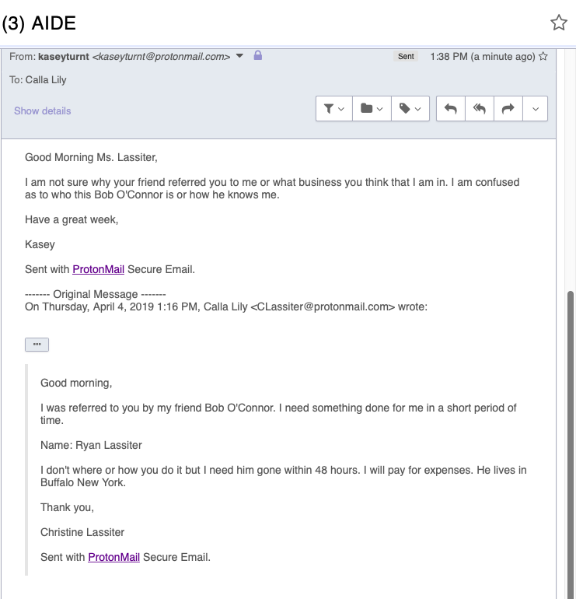
Evidence

Slide 13
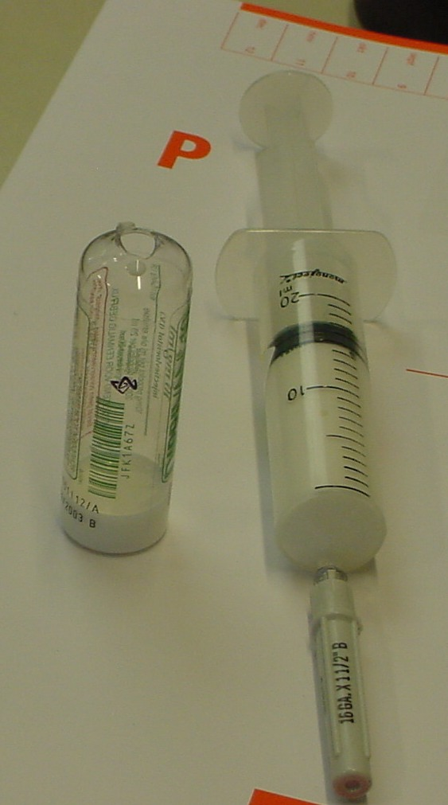
Metadata

Slide 14
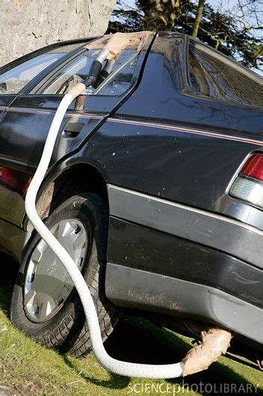
Metadata (Cont.)

Slide 15
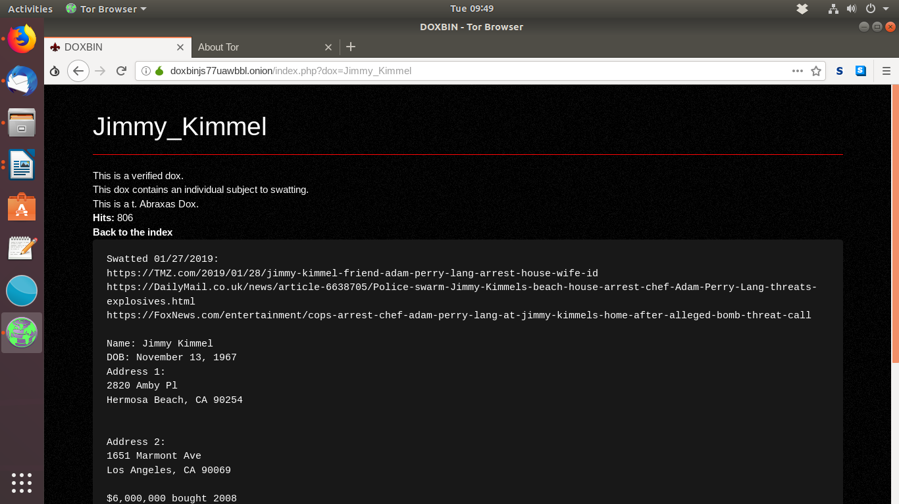
A l’avenir (In the future)
There are screenshots of a website called Doxbin
It is a website that holds personally identifiable information
This can show that the murderer is a contract killer

Slide 16
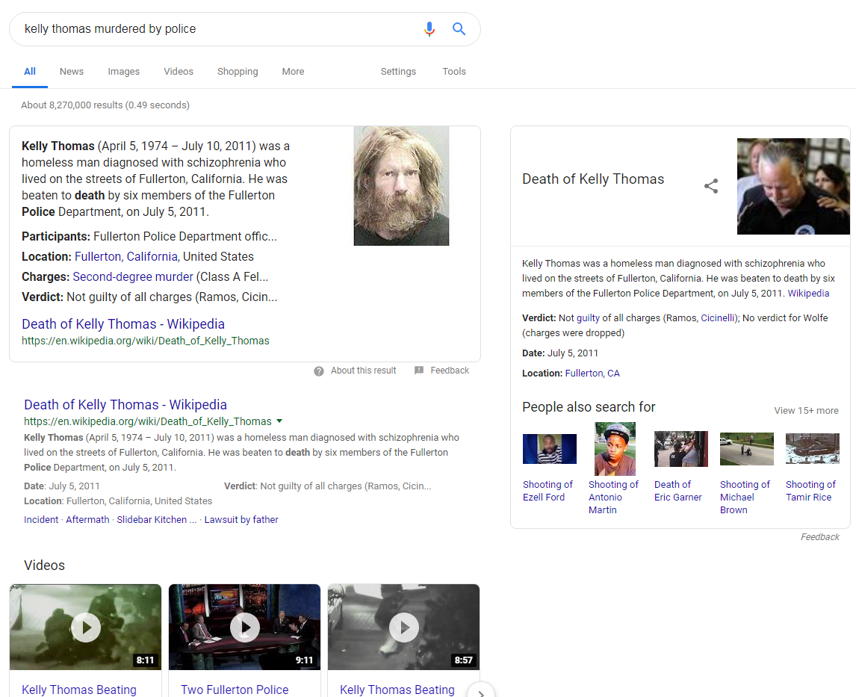
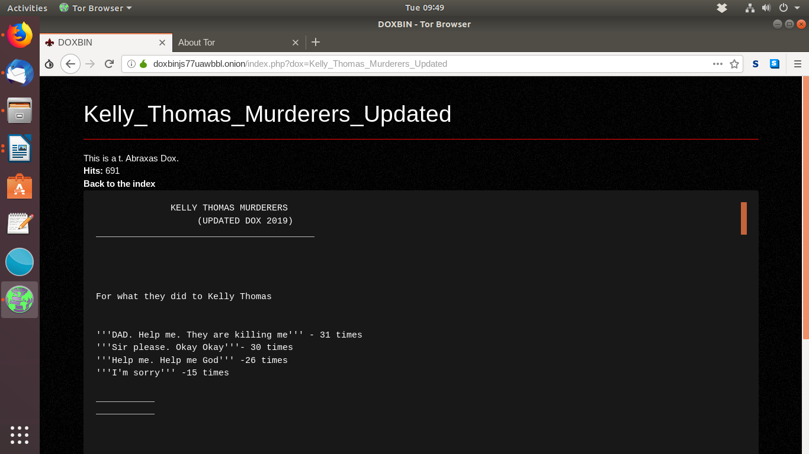
In the future cont.

Slide 17
Online Investigations
There are numerous steps and rules that need to be covered before starting an online investigation. Usually with online investigation there are undercover agents which go into an organization to dismantle the whole operation by finding supporting evidence against the people in the organization.These undercover officers have certain surveillance techniques which makes them good at what they do.

Slide 18
After Action Review
where everyone involved with the operation will review the positive and negative aspects of the operation. The AAR and any issues (if any) are documented in the comment section of the operational plan form. Then it is sent to the training lieutenant

Slide 19
Cybercriminal tactics & faults
Pieces of evidence that helps bring the investigation to a conclusion is always important. Evidence can come in many forms and support each other. The files given in this investigation was the primary source of evidence that gave answers as to what went on during the time of the “suicide”. Metadata is data that gives more information of other pieces of data. This is important to investigate as this could lead to stronger evidence.

Slide 20
Criminals use different methods to decrease their chances of being detected. One way that the criminale hide messages is Steganography, which is what was seen in this particular case.This is where a criminal hides a message behind an image. This is done so that if any type of file or message is obtained, the message can still be hidden. This makes it harder for the police or anyone else to detect the content of the conversation that could be used as evidence. In this investigation you find hidden messages in photos which in itself raises suspicion.

Slide 21
Cryptography was also used in this case to hide a message. This involves scrambling the message with a key. This is all so that the sender and receiver of a message can insure that the contents of the message stays between them. This is a better approach than creating plain text that could incriminate themselves. In this investigation I found some plain text that could be used as evidence.

Slide 22
[The
murder took place last night. I made it look like an accident, as you requested. "La cible est morte." - Kasey T.]
---------------------------------------------------------------------------------------
employer.pdf
Dark Mamba is an Independent Private Military Company formed by
ex military corps and ex special forces. We operate worldwide.
----------------------------------------------------------------------------------------------------------------------------------------------------------------------------
RULES
1. We accept only Bitcoins
2.
Payment is made AFTER the execution of the job
3. A little advance is needed before starting a job
4. Contact us only if you are really interested
5. Use only .onion mail services to contact us
(We should not receive emails from the clearnet mail services)

Slide 23
Cyber criminals operate in a way that covers their actions. Commiting crimes online could be harder to pull off being that their are so many tools digital forensics investigators use to reveal evidence. Operating on a computer leaves possible evidence saved to your computer. Such as what time you were online, and what your searching interest were. Good cyber criminals think as if they were an investigator. This is how they commit crimes online with little to no loose ends.

Slide 24
Conclusion
Digital forensics is a branch of forensic science encompassing the recovery and investigation of material found in digital devices, often in relation to computer crime.
Cyber crime is a broad category of offenses involving computers and computer networks. Some acts of cybercrime, known as “cyberattacks,” seem intended only to disrupt or destroy computer networks. Internet security experts estimate that the global annual cost of cybercrime approaches $1 trillion.

