Slide 1
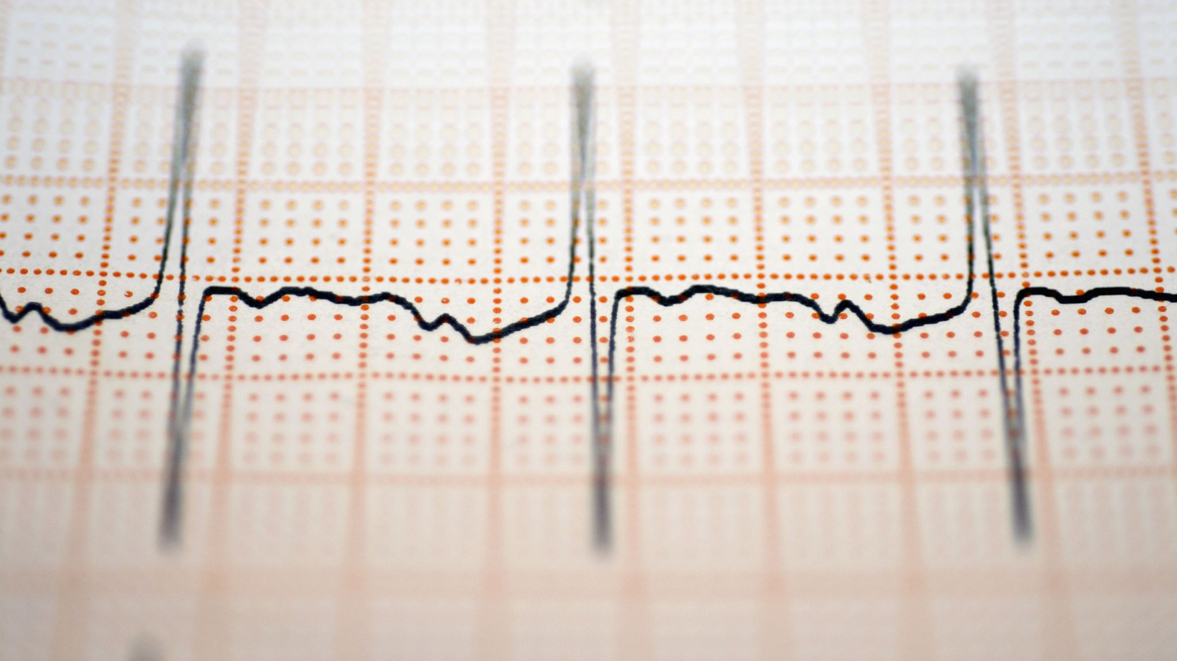
Hypertension
Goal: Learners will confidently recognize hypertension risk factors and feel equipped to implement prevention strategies.

Slide 2
Cognitive Objective
Upon completion of instruction, learners will be able to list at least five risk factors for hypertension as identified by the Centers for Disease Control and Prevention on a post-test.

Slide 3
Outline of Content to Meet Knowledge Objective
Hypertension: the force of blood pushing against the artery walls is too high, blood pressure levels >130/80.
Known as a “silent killer,” because it often shows no symptoms.
Although there are rarely symptoms, people with high blood pressure may have headaches, shortness of breath, or nosebleeds.
Risk factors: physical inactivity, unhealthy diets, diabetes, obesity, pregnancy, alcohol and tobacco use, family history, older age, female sex, African-American ethnicity.

Slide 4
Instructional Method, Materials and Time for Knowledge Content
For the portion of this content, I will create a PowerPoint presentation. I will also use a lecture. I will administer a 5-question verbal post-test at the end of instruction, which will take approximately 5 minutes.

Slide 5
Psychomotor Objective
By the end of the teaching session, learners will demonstrate measuring a blood pressure level according to protocol and obtain a reading within 6 points of the nurse’s reading.

Slide 6
Outline of Content to Meet Skills Objective
How to Measure Your Blood Pressure
Rest for at least 5 minutes before measuring your blood pressure. Sit in a chair with your back supported and keep your feet flat on the floor. Rest your arm on a table so it is at heart level.
Wrap the cuff around your upper arm. The bottom edge should be around 1” above your elbow. Make sure it’s snug, but not too tight (allow room for two fingers). Align the cuff’s artery marker with the inside of your arm.
Place the diaphragm of your stethoscope on the inside of your arm. Inflate the cuff until the reading gets to 160-200 mmHg. Slowly release the pressure. Listen for the heart sounds with your stethoscope. The first sound you hear is the systolic (top) number. The last sound is the diastolic (bottom) number.
Record your readings. Note the date and time, blood pressure level, and any additional notes (what you were doing before you took it, stress, symptoms, etc.)

Slide 7
Instructional Method, Materials, and Time for Skills Content
For the skills portion, I will demonstrate how to measure a blood pressure level according to protocol using a blood pressure cuff and a stethoscope. Proper placement will be shown by placing it on my own arm and demonstrating the skill on myself.
This portion will last approximately 10 minutes as I observe return demonstrations by the learners.

Slide 8
Affective Objective
Upon completion of the teaching session, the learner will demonstrate a willingness to implement lifestyle changes by committing to incorporating at least one prevention strategy into their daily routine for the next week.

Slide 9
Outline of Content to Meet Attitude Objective
What are some ways you can prevent high blood pressure?
Do you already do any of these preventative strategies? Are there some you have not been doing, but think you should?
Is there one you are willing to try out for the next week?
Do you have any questions or concerns?
Feel free to ask any questions you have, and we can figure it out together.

Slide 10
Instructional Method, Materials, and Time for Attitude Content
To wrap up this teaching session, I will ask for volunteers to describe hypertension and define some risk factors. I will write their answers on a whiteboard so everyone can see.
Next, I will ask for a volunteer to review the steps of measuring a blood pressure level as I write these down.
Then I will review preventative strategies with them and ask them to each verbalize one strategy that they plan to incorporate throughout the next week. I will write these on the whiteboard as well. I will ask for questions or clarifications.
This should last about 5 minutes.

