Slide 1
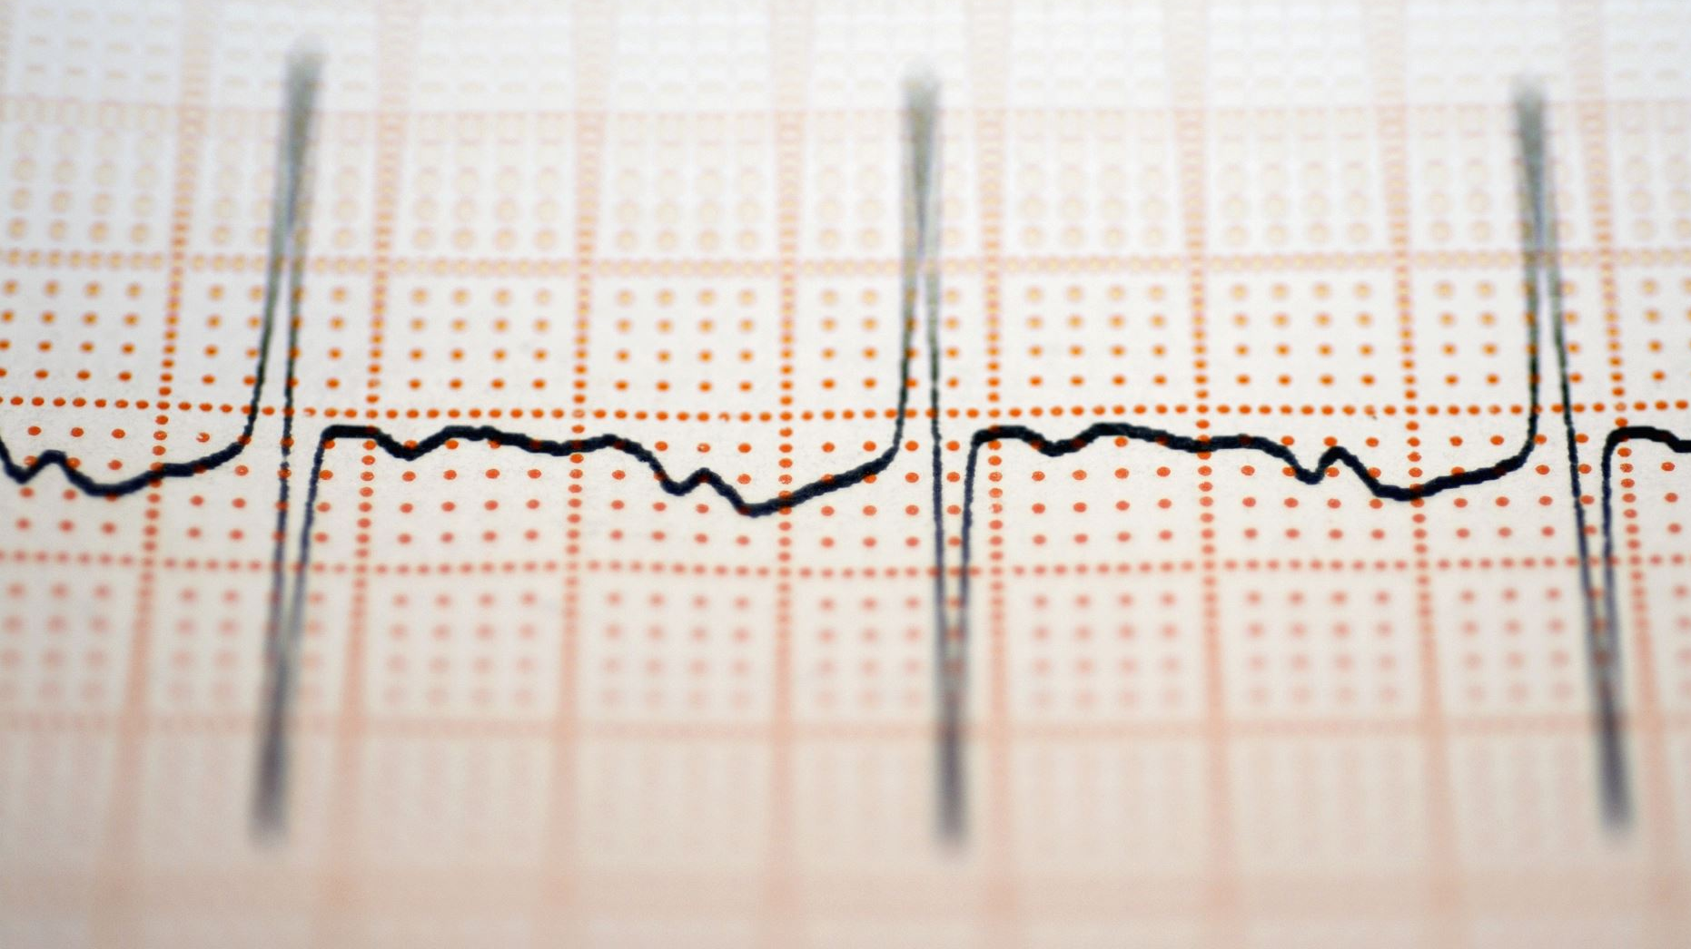
Hypertension

Slide 2
What is hypertension?
The force of blood pushing against the artery walls is too high, >140/90 (World Health Organization, 2025).
Known as a “silent killer,” because many people show no symptoms.
Although there are rarely symptoms, people with hypertension may have headaches, shortness of breath, or nosebleeds.

Slide 3
Key Facts (from the World Health Organization)
An estimated 1.4 billion adults aged 30–79 years worldwide had hypertension in 2024; this represents 33% of the popluation in this age range.
Two-thirds of adults aged 30–79 years who have hypertension live in low- and middle-income countries.
An estimated 600 million adults with hypertension (44%) are unaware that they have the condition.
Approximately 630 million adults with hypertension (44%) are diagnosed and treated.
Approximately 320 million adults with hypertension (23%) have it under control.
Hypertension is a major cause of premature death worldwide.

Slide 4
Risk Factors for Hypertension
Physical inactivity
Unhealthy diets (high in sodium, low in potassium)
Diabetes
Alcohol and tobacco
Obesity
Family history of high blood pressure
Pregnancy
Older age
Male sex until around age 60, then female sex older than 60.
African-American ethnicity

Slide 5

Preventative Strategies for Hypertension
Eat a healthy diet: low sodium, plenty of fruits and vegetables, foods rich in potassium, fiber, and protein. (DASH Diet)
Keep yourself at a healthy weight
Participate in regular physical exercise (at least 30 minutes a day)
Do not smoke
Get enough sleep
Manage stress
Perform regular blood pressure screenings

Slide 6
Post-test:
How Well Do You Remember?
What is hypertension?
What are 5 risk factors of hypertension listed in the Centers of Disease Control and Prevention that we just talked about?

Slide 7
How to Measure Your Blood Pressure
Rest for at least 5 minutes before measuring your blood pressure. Sit in a chair with your back supported and keep your feet flat on the floor. Do not cross your legs. Rest your arm on a table so it is at heart level.
Wrap the cuff around your upper arm. The bottom edge should be around 1” above your elbow. Make sure it’s snug, but not too tight (allow room for two fingers). Align the cuff’s artery marker with the inside of your arm.
Place the diaphragm of your stethoscope on the inside of your arm. Inflate the cuff until the reading gets to 160-200 mmHg. Slowly release the pressure. Listen for the heart sounds with your stethoscope. The first sound you hear is the systolic (top) number. The last sound is the diastolic (bottom) number.
Record your readings. Note the date and time, blood pressure level, and any additional notes (what you were doing before you took it, stress, symptoms, etc.)

Slide 8
Discussion and Wrap-Up
What are some ways you can prevent high blood pressure?
Do you already do any of these prevention strategies? Are there some you have not been doing, but think you should?
Is there a prevention strategy you are willing to try for the next week?
Who is someone you can identify as being accountable to in implementing your prevention strategy this week?
Questions or concerns?

Slide 9
Thank you for being here!

