Slide 1

Why Cybercrime?
Caleb Judy

Slide 2
Overview
Internet Crime Complaint Center (IC3)
Partnership between the Federal Bureau of Investigation (FBI) and National White Collar Crime Center (NWCC)
It is a centralized reporting system for internet-related crimes
Includes cryptocurrency crimes, scams, etc
Using data collecting by the IC3, it can identify emerging trends, develop investigative strategies, and assist law enforcement in combating cybercrime.

Slide 3
Overview cont.
FBI Cryptocurrency Fraud Report 2023
Highlights the significant increase in cryptocurrency-related fraud in 2023
Substantial losses, from multiple states and countries, reported
Key insights:
The rise of cryptocurrency fraud
Scamming techniques
Role of cryptocurrency kiosks
The threat of recovery scams
The FBI’s response to cryptocurrency-related crime

Slide 4
Key insights
As mentioned in the previous slide, some key insights from the report include:
The rise of cryptocurrency fraud
Scamming techniques
Role of cryptocurrency kiosks
The threat of recovery scams
The FBI’s response to cryptocurrency-related crime
Let’s dive into these insights!

Slide 5
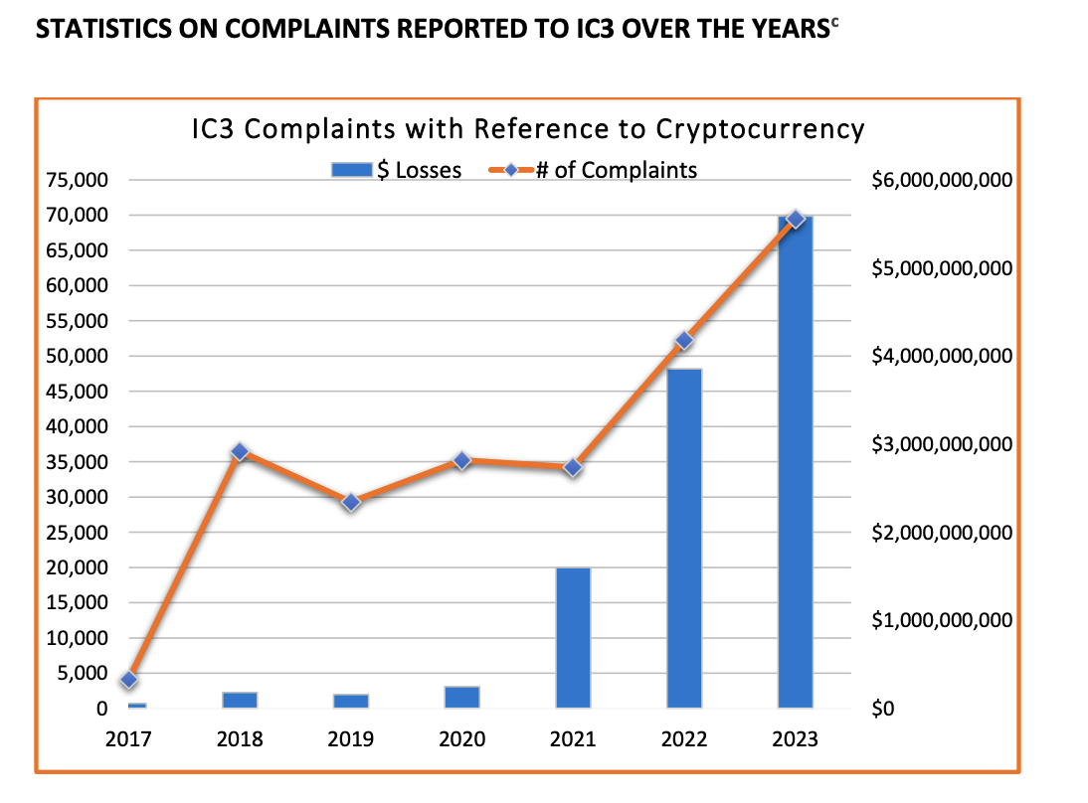
Key insights cont.
The rise of cryptocurrency fraud
The report acknowledges how cryptocurrency fraud has become an issue in recent years
This graph from the report highlights how the number of complaints AND the value in losses has increased

Slide 6
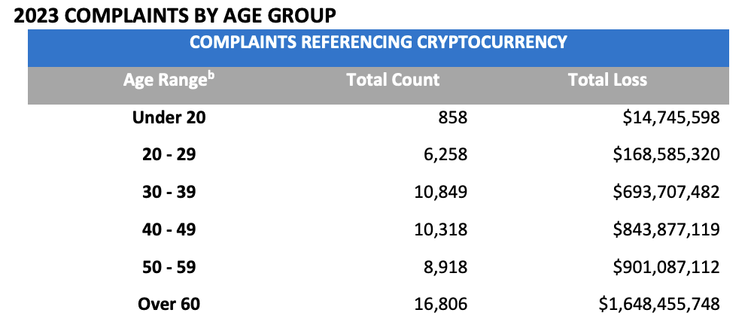
Key insights cont. (rise of crypto fraud)
Highlights the increasing number of scams targeting individuals and businesses.
For example, this graph from the report indicates the age range of individuals affected

Slide 7
Key insights cont. (scamming techniques)
The report highlights diverse scamming techniques
Social engineering
Building trust of victims and manipulating them into giving up personal information through social media, messaging apps, etc.
False promises (manipulation)
Crypto scammers will often offer suspiciously high returns on investments (too good to be true)
Get rich quick

Slide 8
Key insights cont. (scamming techniques)
Phishing attacks
Sending fraudulent messages or emails with the intent of getting victims to reveal personal information
Ransomware attacks
Encrypting the data of victims, decryption is possible through payment in cryptocurrency

Slide 9
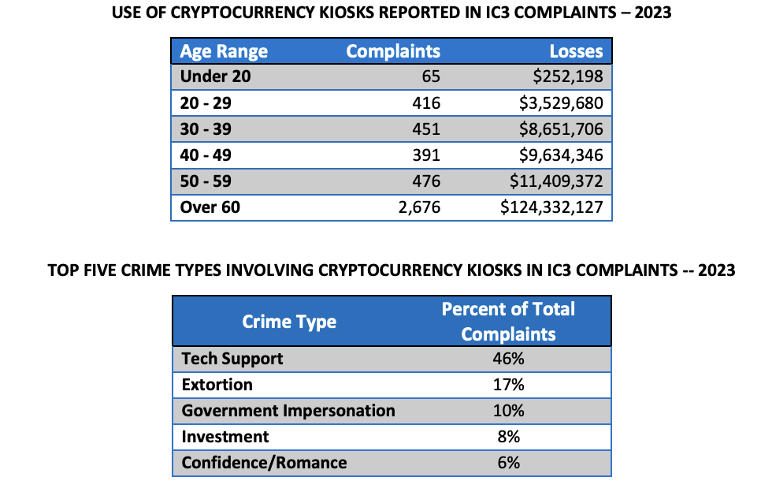
Key insights cont. (kiosks)
Cryptocurrency kiosks
Allows users to buy and sell various cryptocurrencies
These kiosks are exploited by cybercriminals
Offer anonymity, which makes it easier to launder money and evade law enforcement

Slide 10
Key insights cont. (recovery scams)
The threat of recovery scams
A “secondary scam”
Victims of crypto scams often targeted by recovery scams by preying on the desperation of victims by promising their lost funds at a small cost
Victims lose more money

Slide 11
Key insights cont. (FBI response)
Response of the FBI to crypto crimes
Virtual Assets Unit (VAU)
Team dedicated to investigating cryptocurrency-related crimes
Collaborates with other nations and uses advanced technology to combat the threat of crypto crimes

Slide 12
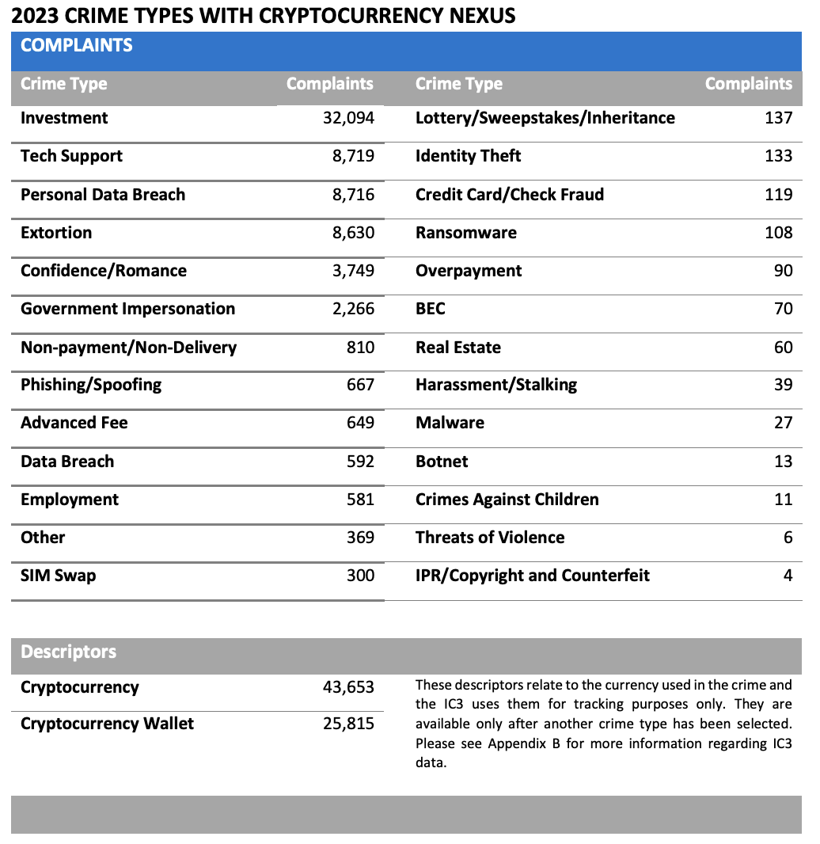
Investment scams
One specific type of cybercrime discussed in the report is investment scams
Involves deceptive tactics to lure victims into investing in fraudulent crypto projects
According to this chart in the report, investment scams were actually the HIGHEST reported complaint

Slide 13
Investment scams cont.
These investment scams have resulted in:
High financial losses
Scammers will use a variety of tactics to trick their victims into investing
Phishing
Social engineering
False promise of high returns (too good to be true)

Slide 14
Investment scams cont.
How to these investment scams typically play out?
Scammers will often build relationships with their victims (social engineering) through messaging apps, social media, etc.
Once trust is gained from the victim, the scammer will introduce the topic of cryptocurrency investment
The scammer will then promise high returns at a low risk, convincing the victim so using their “expertise” or “insider knowledge”
Then, the victim is directed to a website or app controlled by the scammers

Slide 15
Investment scams cont.
How to these investment scams typically play out? Cont.
Once directed to a fraudulent website, scammers often show the victim fake profits or allow small withdrawals, to gain more trust
Once the scammer gets the victim to invest, they may ask for additional fees as a way to get more money from the victim

Slide 16
Investment scams cont.
How to protect yourself
The report includes information on how to protect yourself from these investment scams. You can:
Be skeptical
Verify information
Avoid high-pressure tactics
Use regulated platforms
NEVER share your private keys
Be cautious on social media/messaging apps
Report scams

Slide 17
Routine Activities Theory
Explaining investment scams using routine activities theory
Three parts:
Motivated offender
Suitable target
Absence of capable guardians

Slide 18
Applying routine activities theory
Motivated offender
What would an investment scammer be motivated by?
The potential for a significant financial gain
Their knowledge and skills, like technical expertise and social engineering, can help them earn a profit unethically

Slide 19
Applying routine activities theory cont.
Suitable target
Who would be a suitable target for an investment scam?
Someone with a large amount of money and an interest in cryptocurrency investments
Someone who is not financially savvy or naive to investment scams
Someone who is actively online is more vulnerable to investment scams

Slide 20
Applying routine activities theory cont.
Absence of capable guardians
What guardians or protections are absent to protect victims?
Weak regulatory frameworks
Limited consumer protection
A lack of digital literacy

Slide 21
Thanks!

Slide 22
Citations
1. “2023 Cryptocurrency Fraud Report.” IC3, Internet Crime Complaint Center, 2023, www.ic3.gov/AnnualReport/Reports/2023_IC3CryptocurrencyReport.pdf.
2. Graham, Roderick S, and ’Shawn K Smith . “Cybercrime and Digital Deviance: Roderick S. Graham, ’Shawn K. Smith.” Taylor & Francis, Taylor & Francis, 30 Apr. 2024, www.taylorfrancis.com/books/mono/10.4324/9781003283256/cybercrime-digital-deviance-roderick-graham-shawn-smith.

